Slide 1
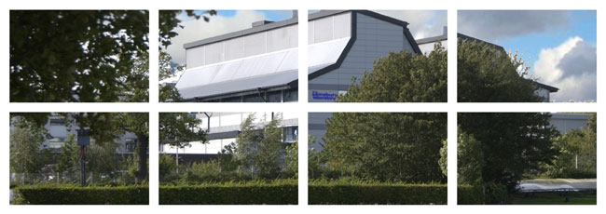
A presentation
on
Surface Immunity
Cyril Zipfel
cyril.zipfel@tsl.ac.uk

Slide 2
Keynote lecture
Dr Stefanie Ranf
Technical University, Munich, Germany
“Specificity of LORE-dependent lipopolysaccharide immune sensing in Arabidopsis”
Friday 4th August, 15:30-16:30

Slide 3
Practical session
Maria
Marta
Martin
Tom
Julien
Analysing Surface Immunity
Friday 4th August afternoon + Saturday 5th August morning
DETAILED BOOKLET PROVIDED!

Slide 4
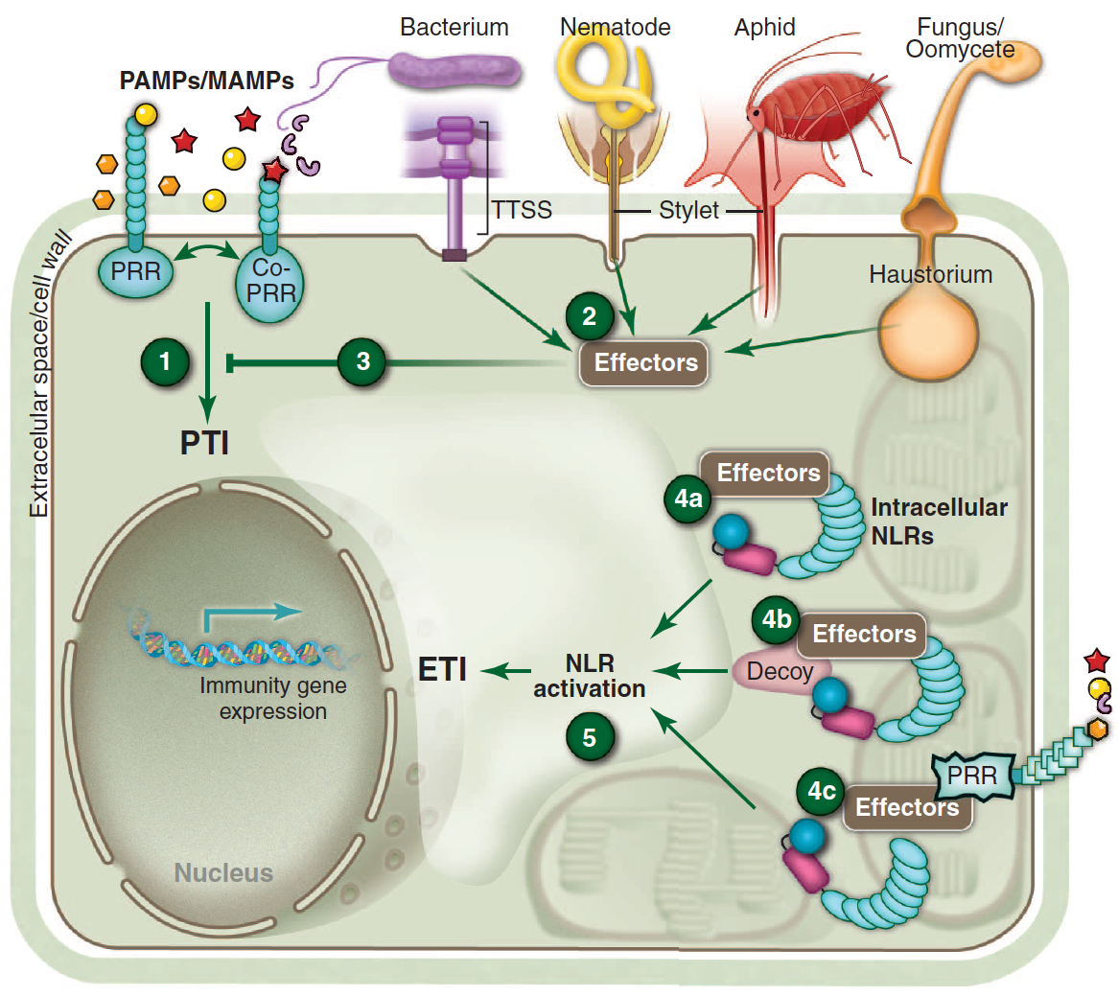
PRR-triggered immunity (PTI): the first layer of plant immunity
SURFACE IMMUNE PERCEPTION
PRR: pattern recognition receptor
PAMP/MAMP: pathogen/microbe-associated molecular pattern
Adapted from Dangl et al., Science 2013

Slide 5
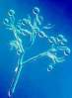
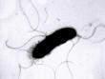
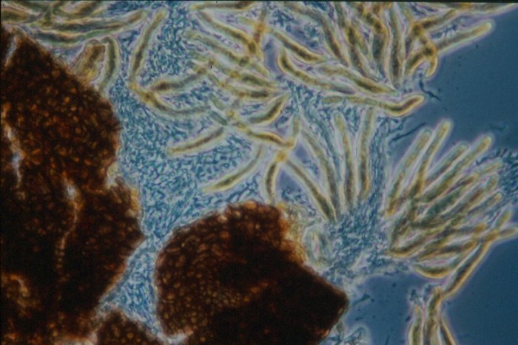
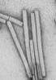
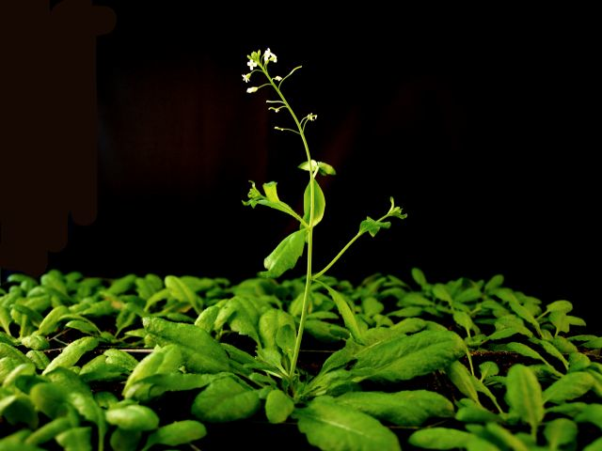
Plants recognize a number of ‘non-self’/’altered-self’ molecules
PAMPs recognized in the plant model
Arabidopsis thaliana
Oomycetes
Fungi
Bacteria
Viruses
- glucans
- Pep13
- INF1
- NPP1
PaNie
CBEL
…
xylanase
chitin
- ergosterol
…
flagellin (flg22)
EF-Tu (elf18)
lipopolysaccharides (LPS)
peptidoglycans (PGN)
- cold-shock protein (csp22)
- RaxX
…
dsRNAs
…
Insects
Nematodes
(e.g. ascarosides)
plant cell
‘danger’ signals
Parasitic plants
(e.g. glycosylated
peptide )
oligogalacturonides
AtPep1
eATP
…
Note: not all PAMPs are recognized by all plant species

Slide 6
Plant PRRs are either receptor kinases or receptor-like proteins
Boutrot & Zipfel, Ann. Rev. Phytopath., 2017

Slide 7
Different epitopes (‘patterns’) within a single PAMP molecule can be targeted by distinct PRRs
Fliegmann & Felix, Nature Plants 2016

Slide 8
Deciphering PTI signaling

Slide 9
PTI: many signalling outputs
Ion fluxes
Oxidative burst
MAP kinase activation
Protein phosphorylation
Immune gene expression
Enhanced ethylene biosynthesis
Callose deposition
Immunity
(Seedling growth inhibition)
sec-min
min
TIME
hours
days

Slide 10

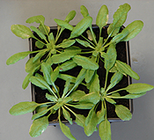
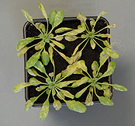
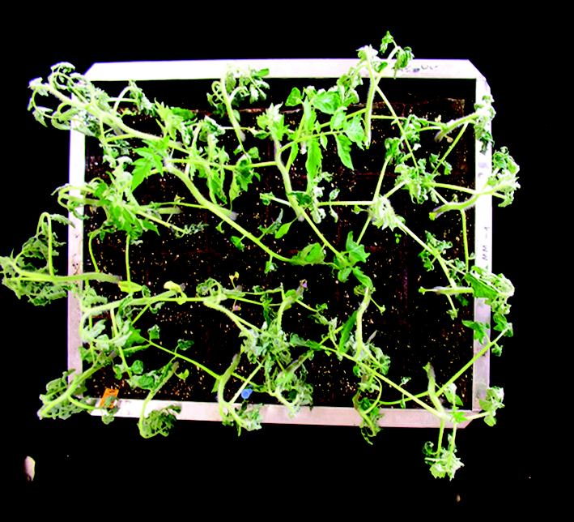
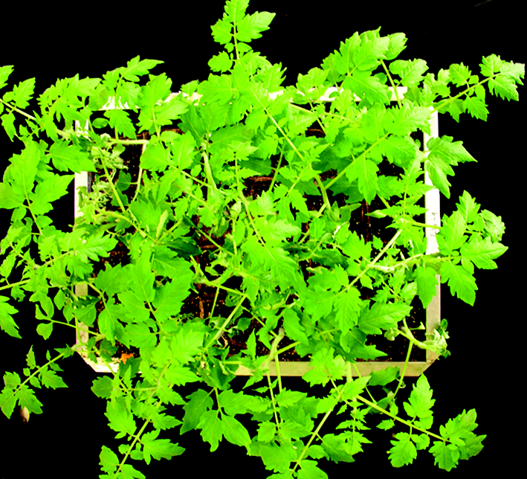
The LRR-receptor kinases FLS2 and EFR as model plant PRRs
Pseudomonas syringae
WT
fls2 efr
FLS2
or EFR
Flagellin (flg22)
or EF-Tu (elf18)
ARABIDOPSIS
Ralstonia solanacearum
WT
+ EFR
out
in
TOMATO
Gomez-Gomez & Boller, Molecular Cell 2000
Zipfel et al., Cell 2006
Zipfel et al., Nature 2004
Zipfel et al., Cell 2006
Nekrasov et al., EMBO J. 2009
Lacombe et al., Nature Biotech. 2010

Slide 11
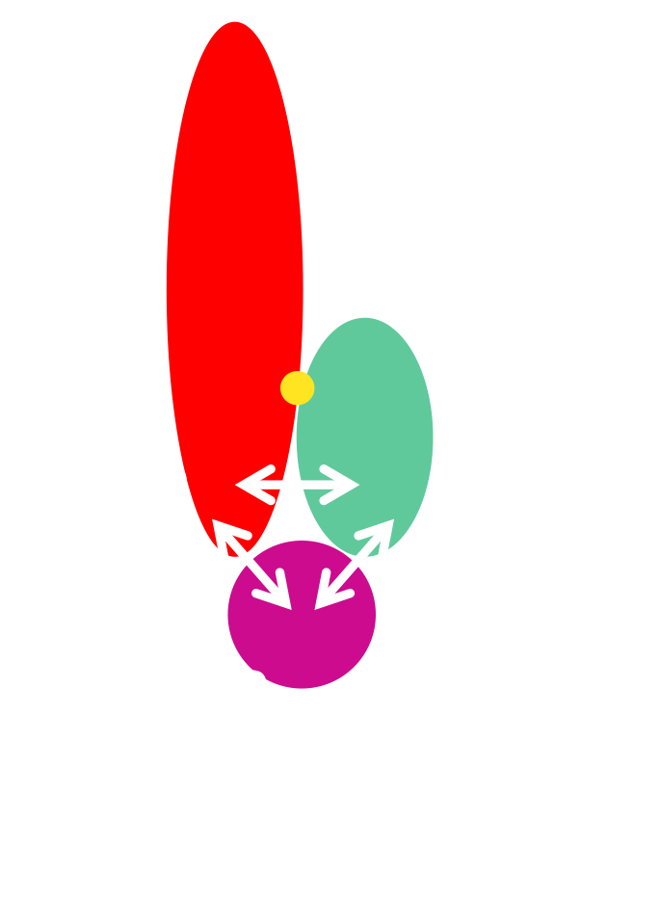
Key steps of FLS2/EFR-BAK1-BIK1 receptor complex regulation
1
Ligand-binding
Sun et al., Science 2013
2
Activation of RK complex
Sun et al., Science 2013
Macho et al., Science 2014
Macho et al., in preparation
Activation of downstream signaling
3
Kadota et al., Molecular Cell 2014
4
Negative regulation
of RK complexes (and PTI signaling)
Segonzac et al., EMBO J. 2014
Monaghan et al., Cell Host Microbe 2014
Couto et al., PLoS Pathogens 2016
5
Signaling specificity
Bücherl et al., in preparation
Perraki et al., in preparation

Slide 12
Paradigm of receptor kinase activation in plants
‘ligand-binding receptor’
‘co-receptor’
PM
P
P
P
‘downstream substrate kinase’
signaling

Slide 13
Paradigms of plant immune/symbiotic receptor kinase activation
Zipfel & Oldroyd, Nature 2017
LRR-type PRRs (RKs or RLPs) use LRR-type RKs (e.g. SERKs) as co-receptors.
LysM-type PRRs (RKs or RLPs) use LysM-type RKs (e.g. CERK1) as co-receptors.
not clear for lectin-type or WAK-type PRRs…

Slide 14
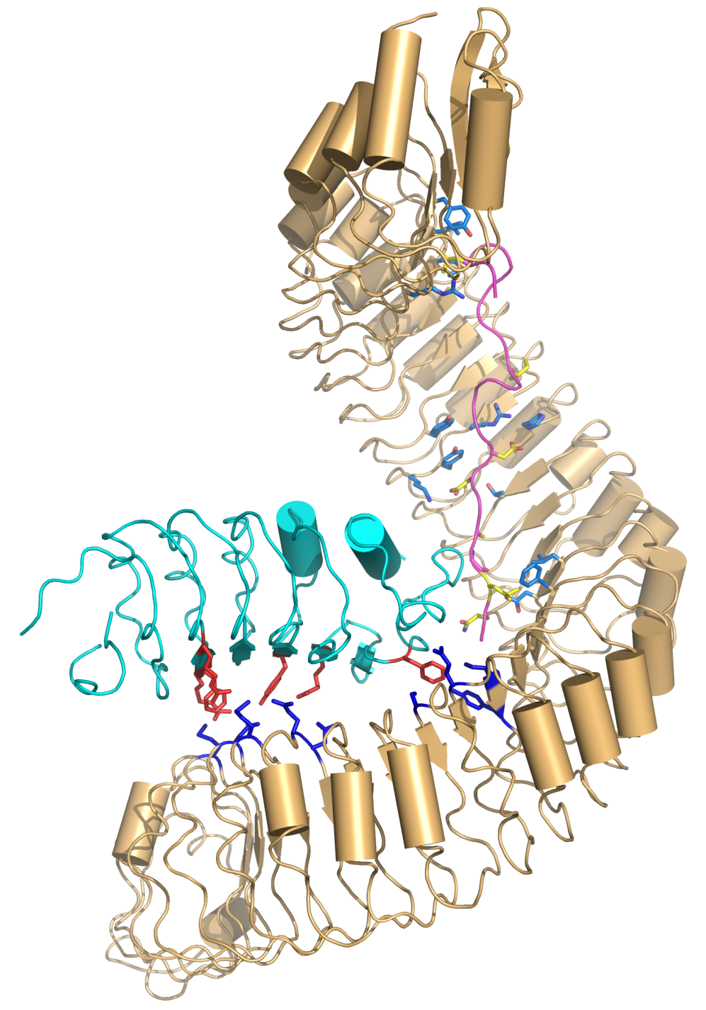
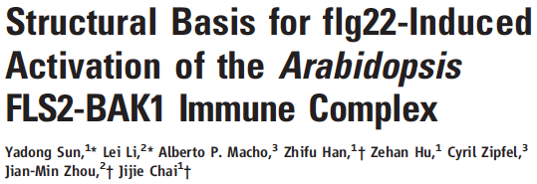

Key steps of FLS2/EFR-BAK1-BIK1 receptor complex regulation
N-terminus
1
Ligand-binding
FLS2
BAK1
flg22
N
C

Slide 15
Initiation of immune signaling by the ‘core’ FLS2/EFR-BAK1-BIK1 receptor complex
FLS2/EFR
‘ligand-binding receptor’
BAK1 (+SERKs)
‘co-receptor’
PM
P
P
BIK1 (+PBLs)
P
‘downstream substrate kinase’
immune signaling

Slide 16

Roles of regulatory RKs in RK complex formation and activation
FLS2/EFR
BAK1
APEX1-3
IOS1
FIR
BIR2
BIR3
Halter et al., Curr Biol 2014
Yeh et al., Plant Cell 2016
Imkampe et al., Plant Cell, in press
Smakowska et al., under revision
Collaborations:
B. Kemmerling (Tübingen)
L. Zimmerli (Taiwan)
Y. Belkhadir (Vienna)

Slide 17
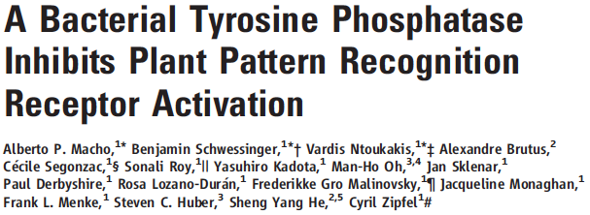
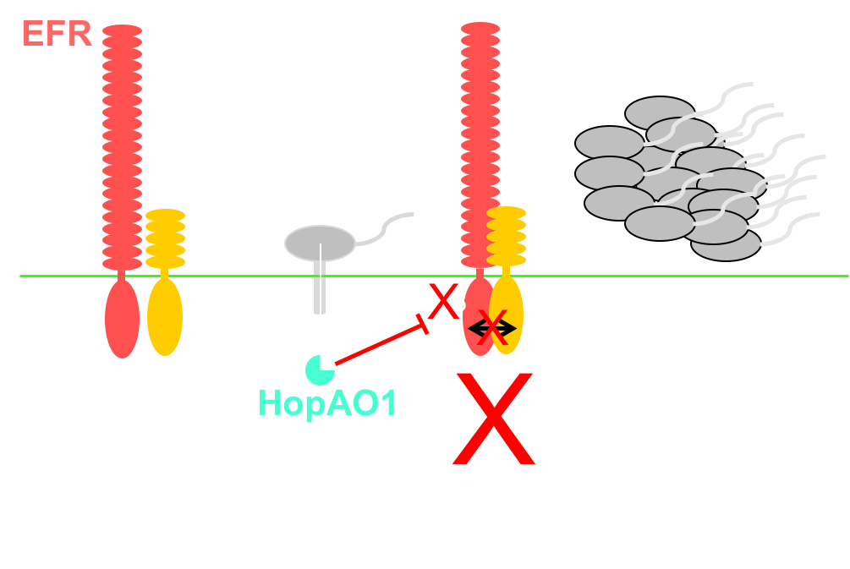
Key steps of FLS2/EFR-BAK1-BIK1 receptor complex regulation
1
Ligand-binding
2
Activation of RK complex

Slide 18
A specific ‘phosphocode’ underlies PTI initiation and specificity
EFR
BAK1
Intracellular juxtamembrane domain
- pT709 (-)
P-loop
- pS753 (-)
- pY836 (+)
?
- pY403 (+)
catalytic loop
Kinase domain
- pS888 (+)
activation
segment
?
pS602 (+)
pT603 (+)
pS604 (+)
Macho et al., Science 2014
Perraki et al., in preparation
D. Couto, M. Font-Farre
TSL Proteomics
C-terminal domain
- pS612 (+)

Slide 19
Key steps of FLS2/EFR-BAK1-BIK1 receptor complex regulation
1
Ligand-binding
2
Activation of RK complex
Activation of downstream signaling
3

Slide 20
Linking activated RK complexes to downstream cellular outputs
RLCKs
Adapted from Couto & Zipfel, Nature Reviews Immunology 2016

Slide 21
Linking activated RK complexes to downstream cellular outputs
rice
Arabidopsis
PAMP
chitin
chitin
flg22
PRR/co-receptor
CeBiP/CERK1
LYK5/CERK1
CeBiP/CERK1
RLCK
RLCK185
PBL27
?
MAPKKK
MAPKKKε
MAPKKK5
?
MKK
MKK4/5
MKK4/5
MKK4/5
MAPK
MPK3/6
MPK3/6
MPK6/3
Yamada et al., EMBO J 2016
Wang et al., Mol Plant 2017

Slide 22
Key steps of FLS2/EFR-BAK1-BIK1 receptor complex regulation
1
Ligand-binding
2
Activation of RK complex
Activation of downstream signaling
3
4
Negative regulation
of RK complexes (and PTI signaling)

Slide 23
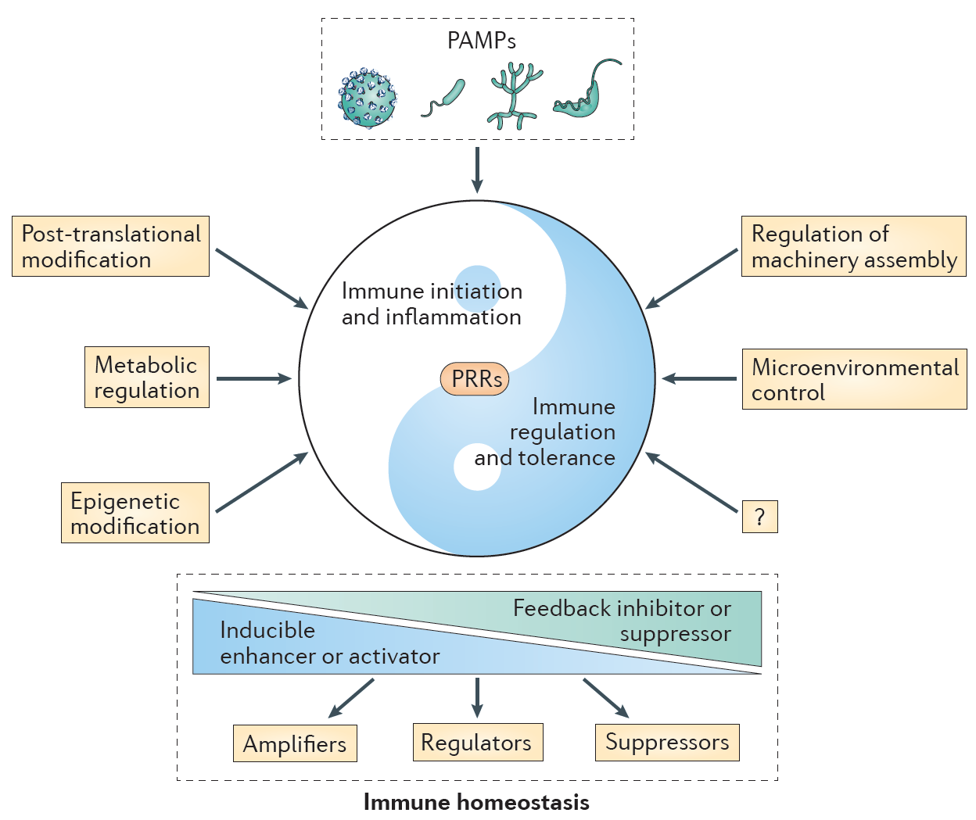
Understanding plant immune signaling homeostasis
Cao, Nature Reviews Immunology 2016

Slide 24
PRR complex activity and turn-over are regulated by dynamic
post-translational modifications
Couto & Zipfel, Nature Rev. Immunol. 2016

Slide 25
PRR complex activity and turn-over are regulated by dynamic
post-translational modifications
PPase
ATPase
Couto & Zipfel, Nature Rev. Immunol. 2016

Slide 26
Key steps of FLS2/EFR-BAK1-BIK1 receptor complex regulation
1
Ligand-binding
2
Activation of RK complex
Activation of downstream signaling
3
4
Negative regulation
of RK complexes (and PTI signaling)
5
Signaling specificity

Slide 27
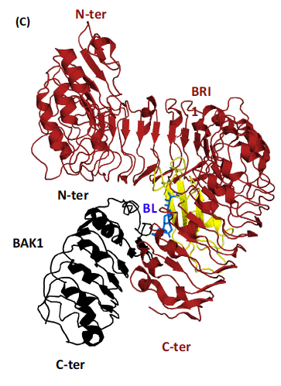
BAK1 is a co-receptor for both FLS2 and BRI1 (and many other LRR-RKs…)
N-terminus
FLS2
BAK1
flg22
N
C
Sun et al., Science 2013
Sun et al., Cell Research 2013

Slide 28
FLS2 and BRI1 are present in distinct spatiotemporal PM nanoclusters
5 μm
2 μm
5 μm
Collaborations: T. Ott (Munich)
Bücherl et al., eLife 2017

Slide 29
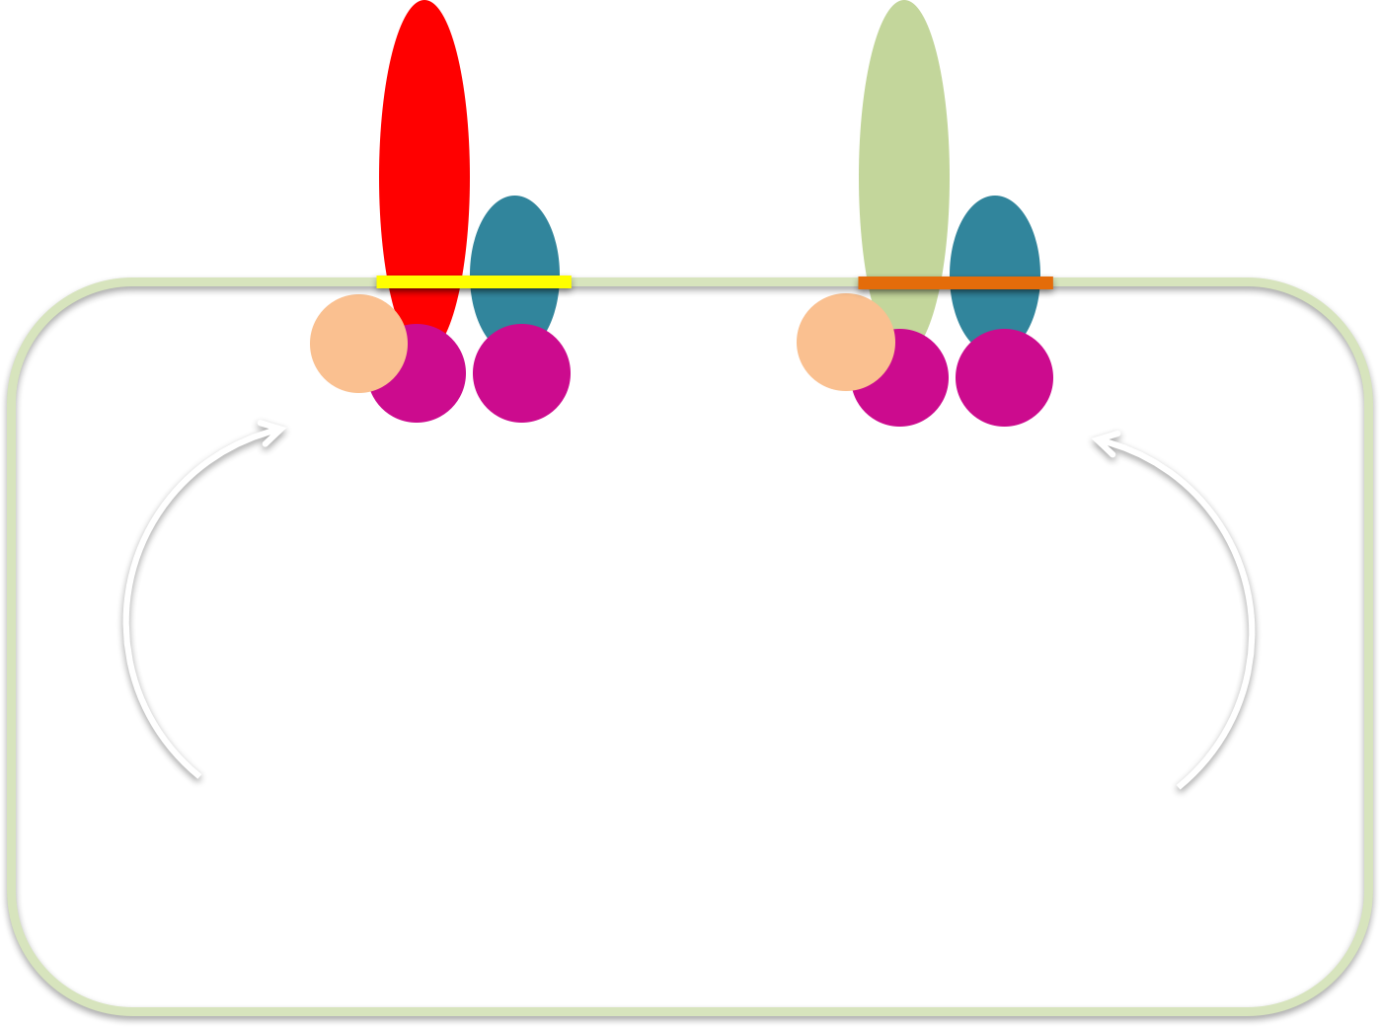
PM organization of pre-formed RK signaling platforms
FLS2
BRI1
BAK1
BAK1
BSK1
BSK1
BIK1
BIK1
biosynthesis/secretion
biosynthesis/secretion
IMMUNITY
GROWTH
Role in signaling specificity?
(together with differential phosphorylation?)

Slide 30
PTI signaling: still many unknowns…
Zipfel & Oldroyd, Nature 2017

Slide 32
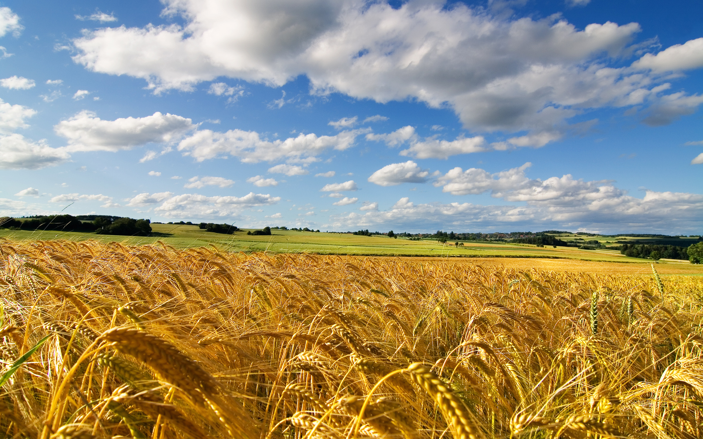
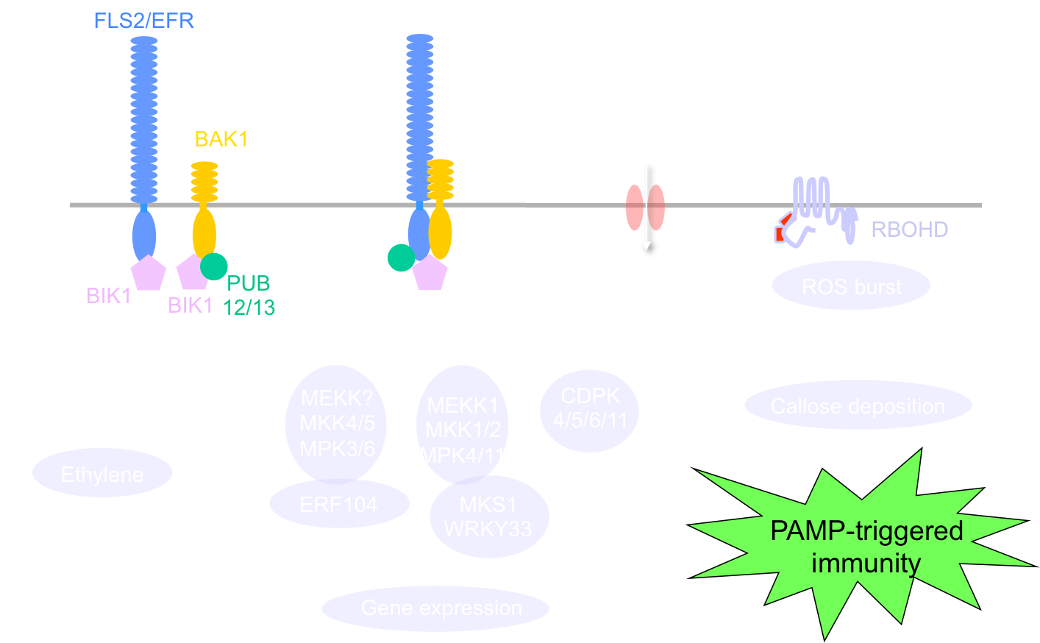
Use of pattern recognition receptors to engineer
broad-spectrum disease resistance in crops

Slide 33
Can we utilize pattern recognition receptors (PRRs)
to engineer broad-spectrum (and durable)
disease resistance in crops?

Slide 34
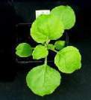
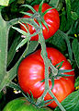
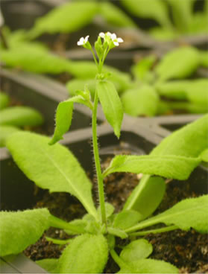
Transfer of PAMP perception across plant families to generate broad-spectrum disease resistance: EFR as a proof-of-concept?
Arabidopsis thaliana
(Brassicaceae)
Solanaceae
Heterelogous
expression of AtEFR
Project partly funded by the Two Blades Foundation (www.2blades.org)
Notes:
34

Slide 35
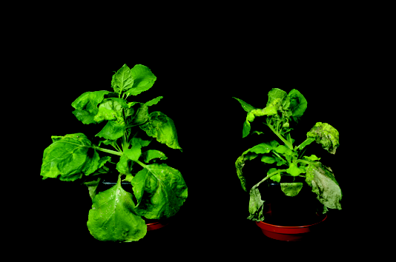
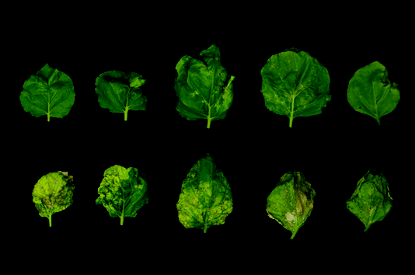
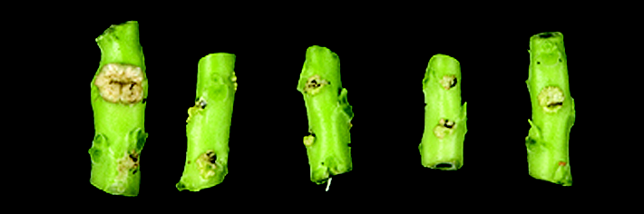
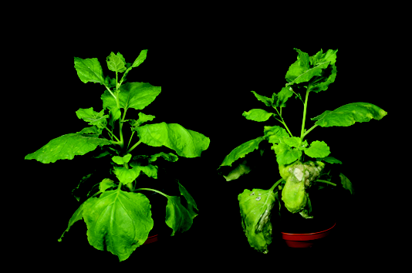
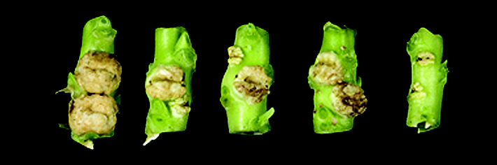
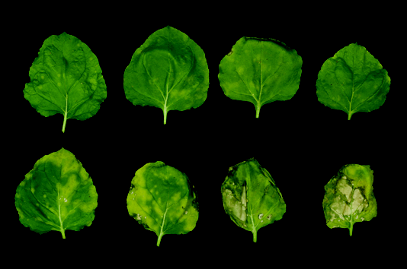
AtEFR expression in Nicotiana benthamiana confers
broad-spectrum resistance to bacteria
Pseudomonas syringae pv. syringae B728a
EFR
WT
9
1dpi
3dpi
2dpi
4dpi
8
*
7
*
*
6
*
EFR
5
Pss B728a (log cfu/cm²)
4
Agrobacterium tumefaciens
3
WT
2
EFR
1
0
WT
EFR
Pseudomonas syringae pv. tabaci 11528
EFR
WT
WT
7
1dpi
3dpi
2dpi
4dpi
6
*
*
*
5
4
*
Pta 11528 (log cfu/cm²)
EFR
3
WT
2
1
0
WT
EFR
Lacombe et al., Nature Biotechnology (2010)

Slide 36
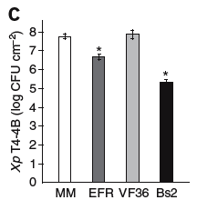
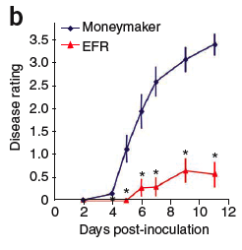
AtEFR expression in tomato confers
broad-spectrum resistance to bacteria
Xanthomonas perforans T4
Ralstonia solanacearum GMI1000
Moneymaker (WT)
EFR
In collaboration with:
N. Peeters, INRA Toulouse, FR
B. Staskawicz, UC Berkeley, USA
Lacombe et al., Nature Biotechnology (2010)

Slide 37
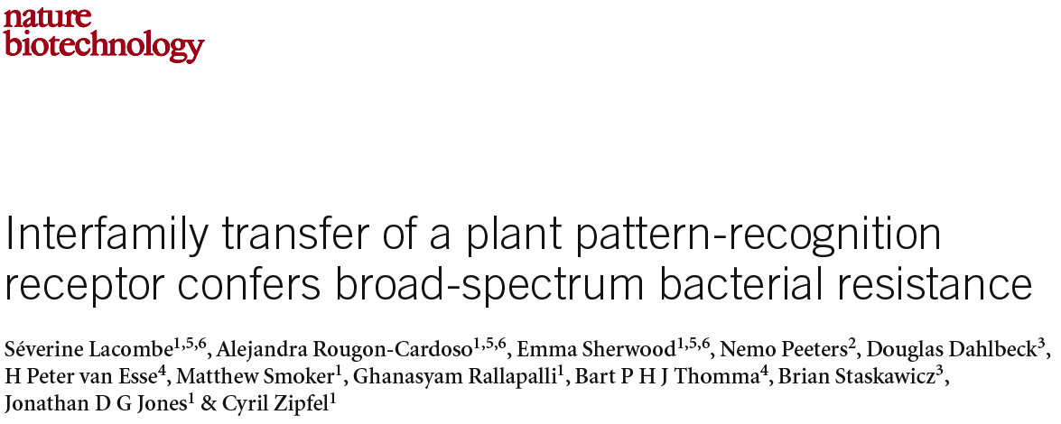
Inter-family transfer of PAMP recognition systems
Inter-family transfer of PRRs is possible indicating that downstream signalling components are conserved.
Transfer of PRRs represent a new strategy to confer broad-spectrum disease resistance.

Slide 38
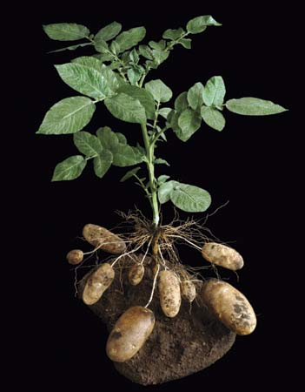
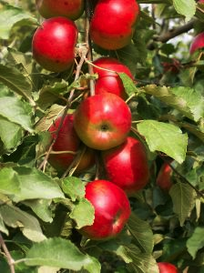
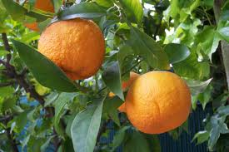
Transfer of EFR to engineer anti-bacterial immunity in crops
Ralstonia solanacearum
Agrobacterium tumefaciens
Pseudomonas syringae
Xanthomonas perforans (including field data!)
Arabidopsis
thaliana
(Brassicaceae)
Solanaceae
Lacombe et al., Nature Biotech. 2010
Coll. with J. Jones and M. Parret (U. Florida. USA)
Ralstonia solanacearum
Coll. with M. Dalla Rizza (INIA, Uruguay)
and J. Kreuze (CIP, Peru)
AtEFR
DICOTS
Erwinia amylovora
Rosaceae
Coll. with M. Malnoy (IASMA, Italy)
Transgenics pending…
Rutaceae
Coll. with G. Moore (U. Florida, USA)
and A. de Souza (IAC, Brazil)
Notes:
38

Slide 39
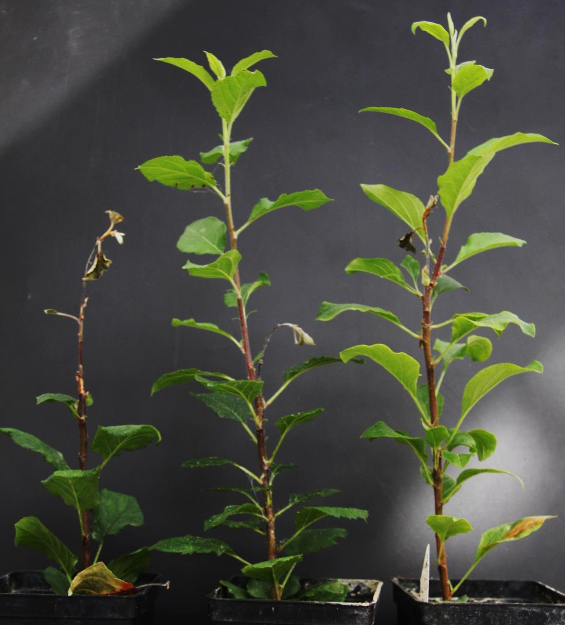
Transfer of EFR into apple for resistance against fire blight
Infection with Erwinia amylovora
Arabidopsis
thaliana
(Brassicaceae)
apple
(Rosaceae)
AtEFR
control
EFR transgenics
Collaboration: M. Malnoy (Fondazione Edmund Mach, IT)
Notes:
39

Slide 40
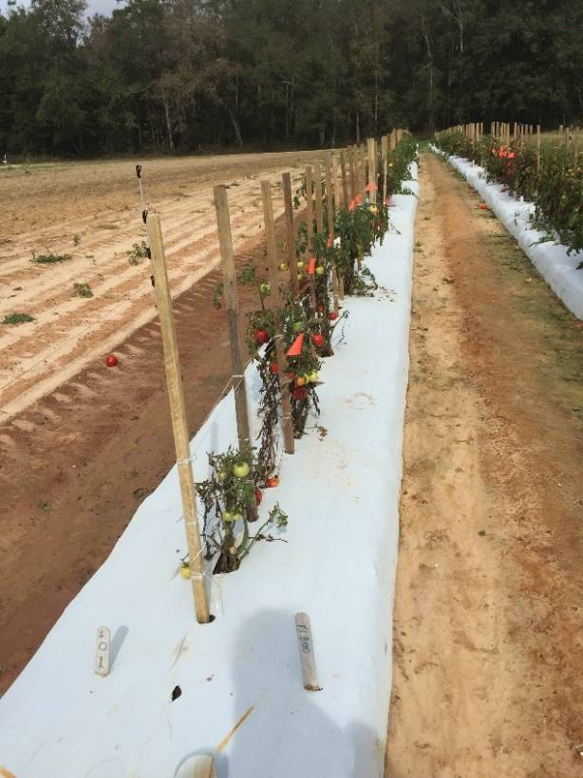
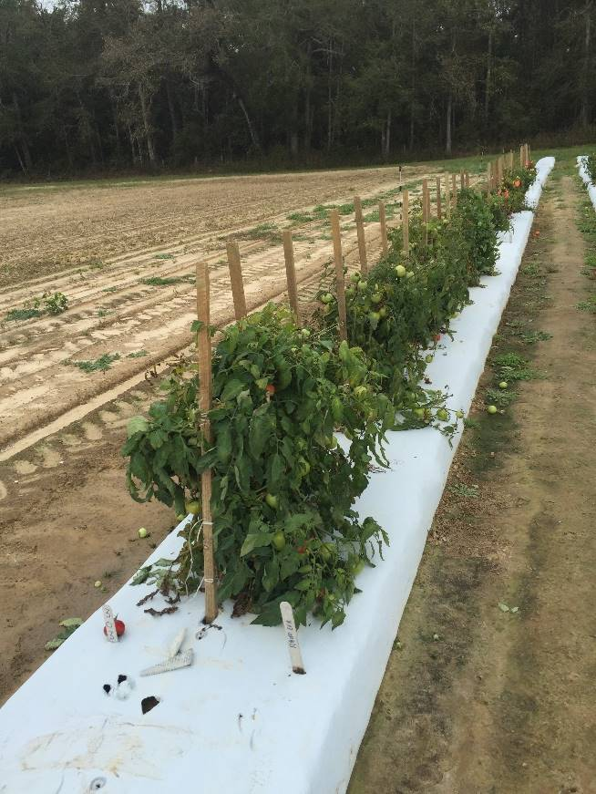
Commercial line
Transfer of EFR into tomato: field trials against bacterial wilt
Commercial line
Commercial line + EFR
with EFR
without EFR
Total yield: 25 kg/hec
Total yield: 52 kg/hec
Coll. with 2Blades, J. Jones and M. Parret (U. Florida)
Notes:
40

Slide 41
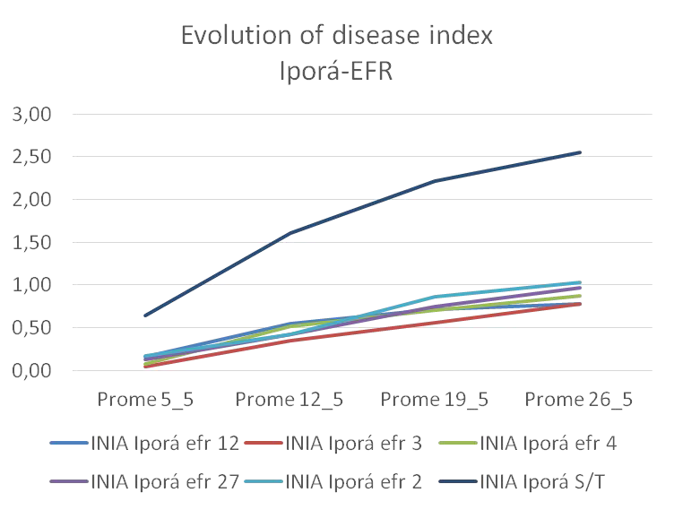
Transfer of EFR into potato: INIA collaboration (Uruguay)
WT
+ EFR
Boschi et al., in prep.
Coll. with M. Dalla-Rizza and F. Vilaró (INIA, Uruguay)

Slide 42
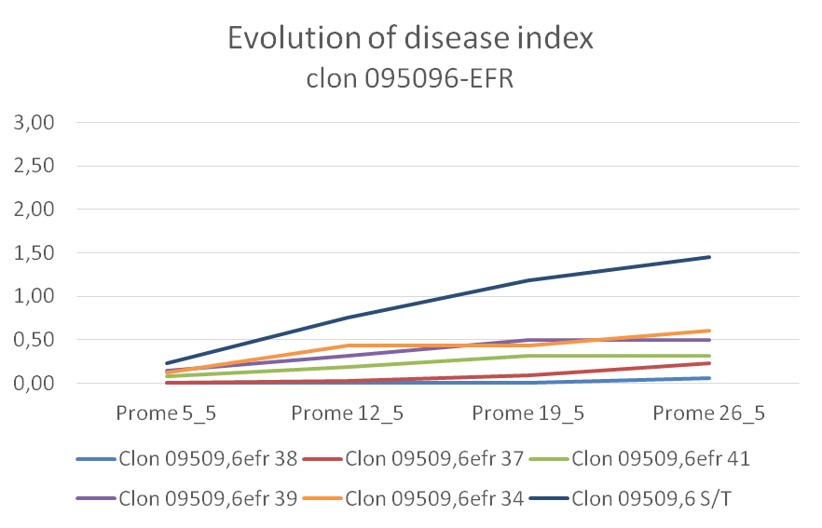
Transfer of EFR into potato: INIA collaboration (Uruguay)
WT
‘WT’
Tolerant
breeding
line
+ EFR
+ EFR
The combination of EFR with the quantitative resistance introgressed from the wild-relative Solanum commersonii renders potato almost fully resistant to Ralstonia solanacearum!
Boschi et al., in prep.
Coll. with M. Dalla-Rizza and F. Vilaró (INIA, Uruguay)

Slide 43
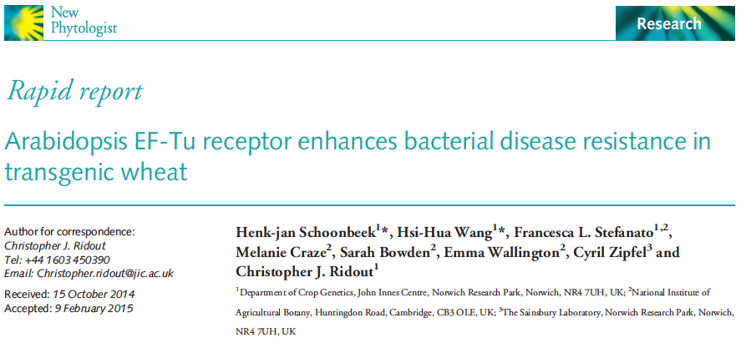
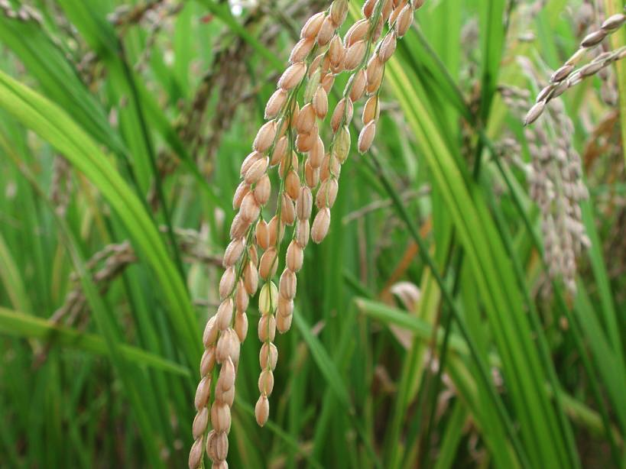
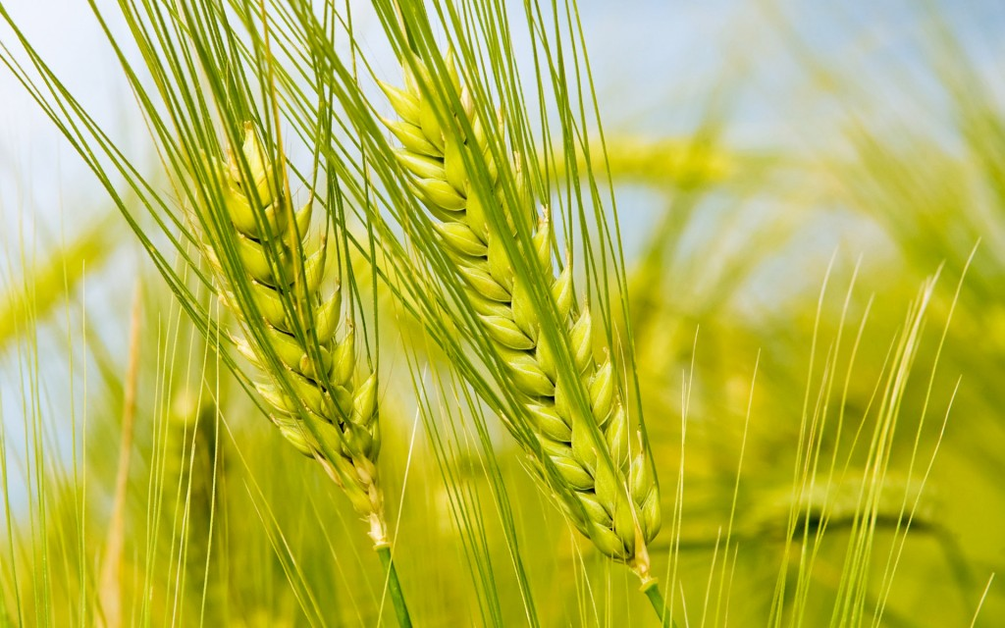
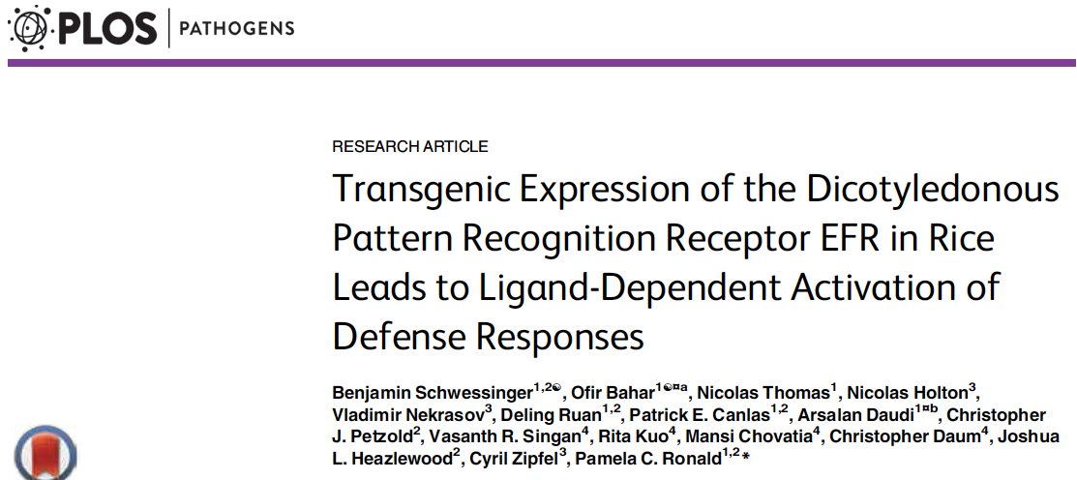
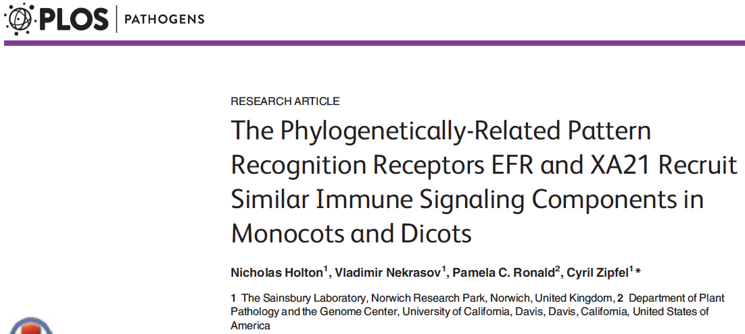
PRR transfer: breaking the monocots-dicots barrier (>150 My)
Poaceae
Brassicaceae
rice
Arabidopsis
AtEFR
wheat
Brassicaceae
Arabidopsis
Poaceae
rice
OsXA21
Solanaceae
N. benthamiana
Collaborations:
P. Ronald (UC Davis)
C. Ridout (JIC)
Notes:
43

Slide 44

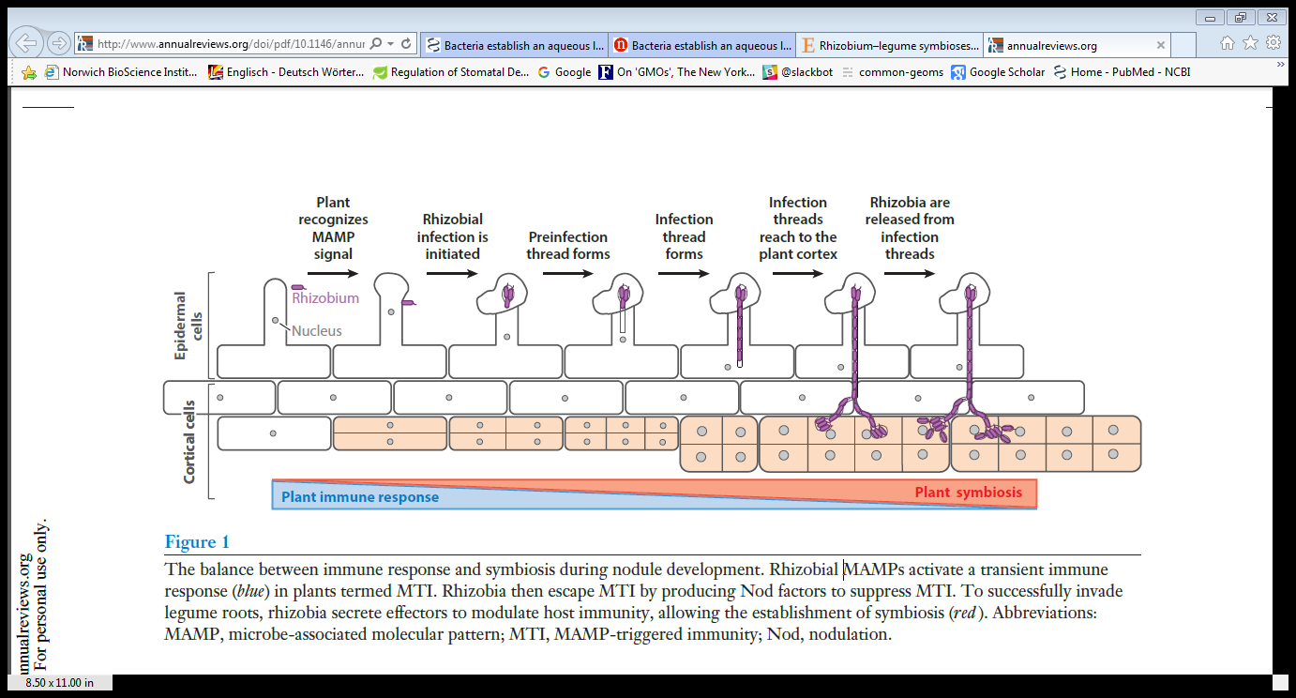
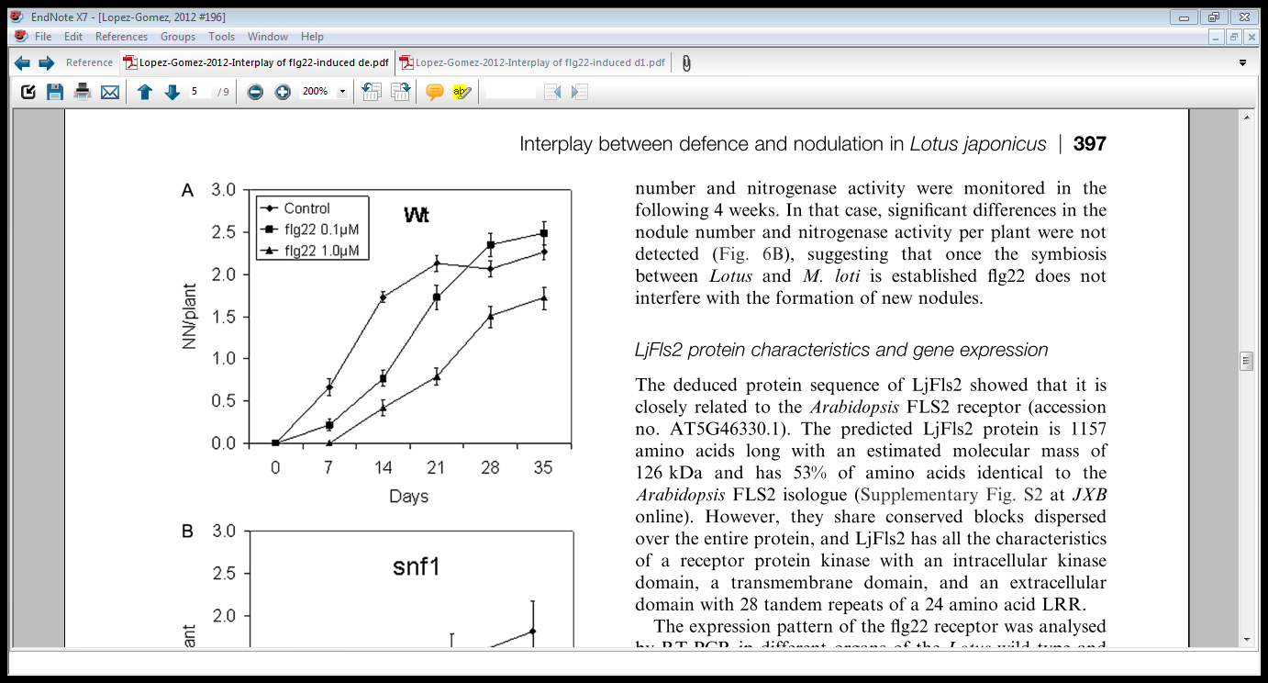
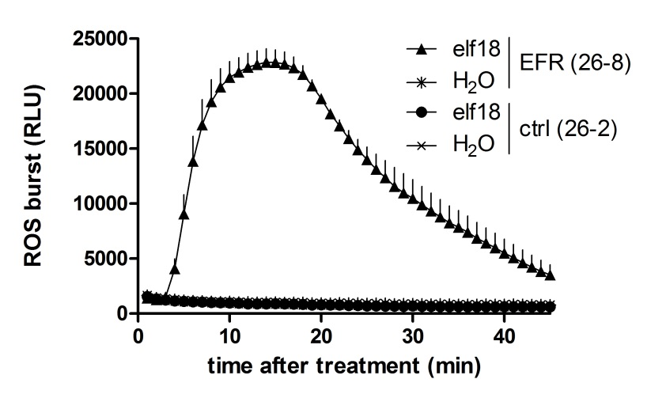
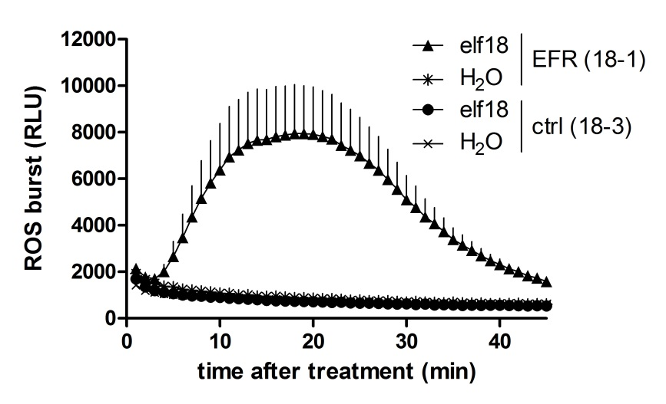

Transfer of EFR to engineer anti-bacterial immunity in crops
Does the gain of EF-Tu recognition affect bacterial symbiotic interactions?
Cao et al., Ann. Rev. Plant Biol. 2017
Lopez-Gomez et al., J. Exp. Bot.. 2012
Arabidopsis
(Brassicaceae)
Medicago
(Fabaceae)
AtEFR
Pfeilmeier et al., bioRxiv 2017

Slide 45



Transfer of EFR to engineer anti-bacterial immunity in crops
Expression of EFR in Medicago does not significantly affect rhizobial symbiosis
Early events (7 dpi)
Nodule number (28 dpi)
5.10⁵ cfu/mL Sm 1021 (lacZ)
5.10⁵ cfu/mL Sm 1021
Nitrogenase activity (28 dpi)
Plant growth (28 dpi)
Pfeilmeier et al., bioRxiv 2017
5.10⁵ cfu/mL Sm 1021
5.10⁵ cfu/mL Sm 1021

Slide 46
Transfer of EFR to engineer anti-bacterial immunity in crops
Expression of EFR in Medicago increases resistance to Ralstonia
26-2_WT
26-8_EFR
18-3_WT
18-1_EFR
Pfeilmeier et al., bioRxiv 2017
Collaboration: N. Peeters, A. Morel (Toulouse)

Slide 47
Transfer of EFR to engineer anti-bacterial immunity in crops
Conclusions
EFR transfer confers enhanced resistance in multiple plant families.
Rhizobium most likely evades or suppress PTI during modulation, or the plant ‘select’ symbionts and commensals…
Unbiased microbiome studies are required to assess the extent to which EFR affects interactions with commensal bacteria…
More field trials are required, although current data suggest that EFR expression does not negatively affects plant traits…

Slide 48






Other examples of successful PRR transfer

Slide 49
Identifying new (family-specific) PRRs to deploy
reverse-genetics
(eg. RKs and RLPs mutant collections,
natural variation)
co-receptors
as molecular baits
(eg. BAK1, CERK1)
PRRs
ligand ‘fishing’
(eg. biotin-peptide)
eg. CSP22 (Saur et al., PNAS 2016)
HT screening using
cell-based assays
N. Holton, F. Boutrot, J. Rhodes
In collaboration with 2Blades Foundation and many other collaborators

Slide 50
No silver bullet… how to maximise the chance of durability?
Pyramiding of PRRs (and NLRs) through breeding and/or trans/cisgenesis
Case study: stacking AtEFR, OsXA21 and/or CaBs2 in tomato >> resistance to Xanthomonas
(project in collaboration with 2Blades Foundation; B. Staskawicz, UC Berkeley; J. Jones, U. Florida)
Combination with genome-editing of susceptibility genes/negative regulators of immune signaling
Combination with biocontrol agents in responsive genotypes
Combination with reduced/less frequent chemical inputs

Slide 51
PRR-triggered immunity (PTI)
SURFACE IMMUNE PERCEPTION
PTI is an important part of the plant immune system.
The study of PTI allows paradigmatic discoveries in receptor kinase biology and plant signaling, in general.
The use of PRRs represent a promising technological approach to engineer broad-spectrum (and potentially durable ) disease resistance in crops.

Slide 52


